Slide 1
FULLSTACK
Backend Programming

Slide 2
Web

Slide 3
Web
Golang provide package net/http
Have some kind of features to make a website
Include : - Routing - Server - Templating - etc

Slide 4
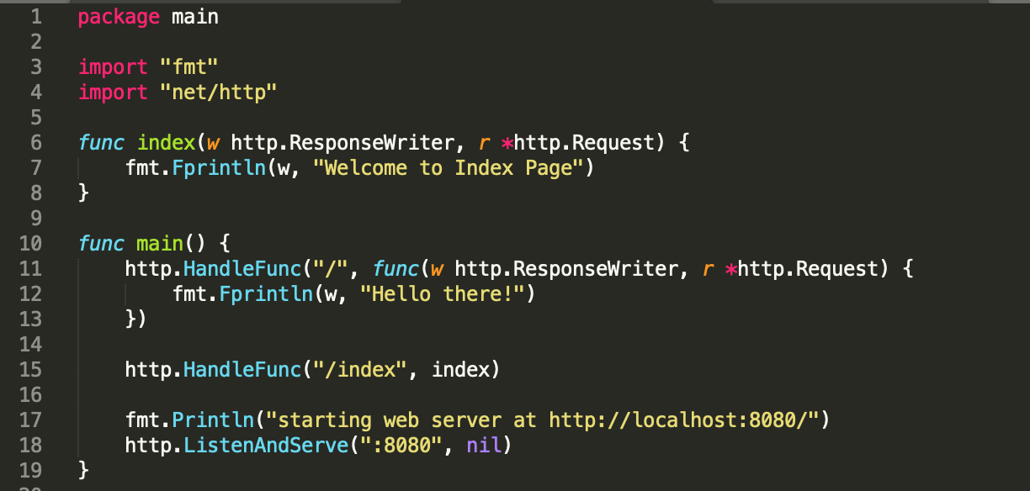
Web

Slide 5
Web
http.HandleFunc is used for routing website.
Routing is determining actions when certain urls are accessed by the user.
http.HandleFunc have 2 parameters. - First parameter is a route that you want - Second parameter is callback or action when the route is accessed

Slide 6
Web
The callback is a function type func(w http.ResponseWriter, r * http.Request)
http.listenAndServe() is used to turn on the server while running the application using the server
Every time there are changes to the .go file, go run must be called again.

Slide 7
URL Parsing

Slide 8
URL Parsing
The url string data can be converted into url.URL
using this type there will be a lot of information that we can use, such as: - Protocol - Path - Query - etc

Slide 9
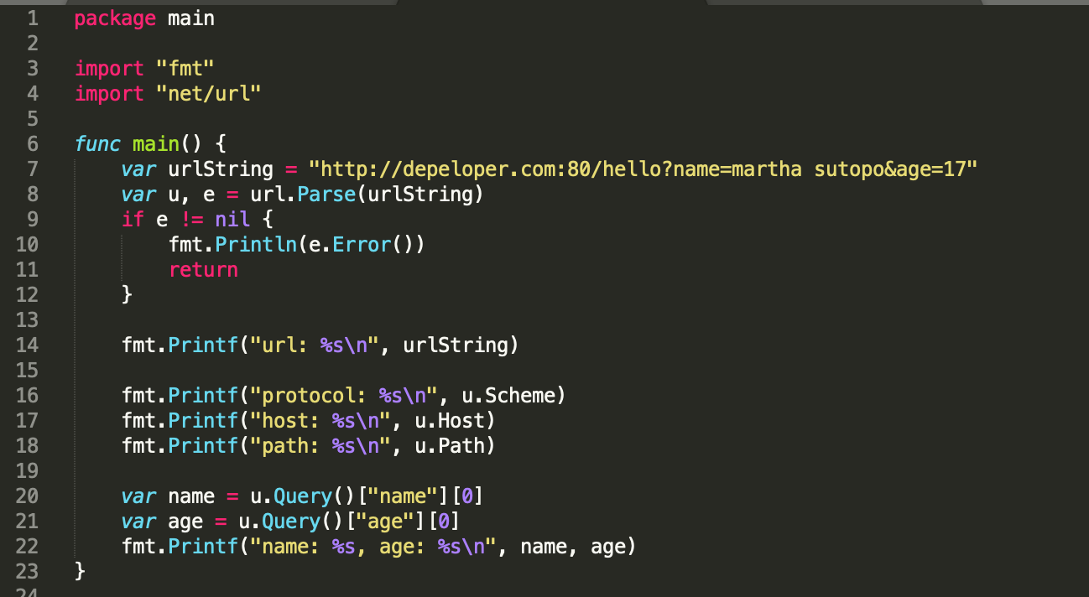
URL Parsing

Slide 10
URL Parsing
url.Parse() is used to parse strings to url forms
Returns 2 data, object variable type url.URL and error (if any)
Passing the object variable accessing url information will be easier For example : - hostname can be obtained via u.Host - protocol via u.Scheme - etc

Slide 11
URL Parsing
In addition, the query on the url will also be automatically parsed, to the form map[string][]string
Key is the name of the query element
Value array string is the value of the query element.

Slide 12
JSON

Slide 13
JSON
JSON is standard notation commonly used for data communication via the web
JSON is a subset of javascript
Golang provide package encoding/json
Using json.Unmarshal, json string can be converted to object

Slide 14
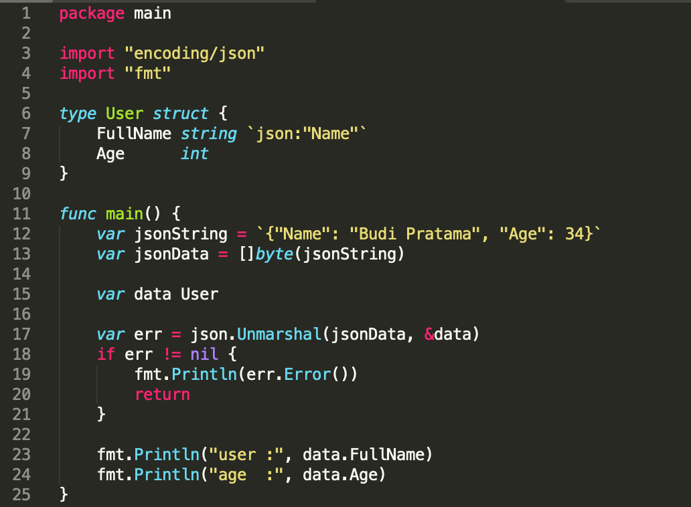
JSON – Decode JSON to Variable Objects of the Struct

Slide 15
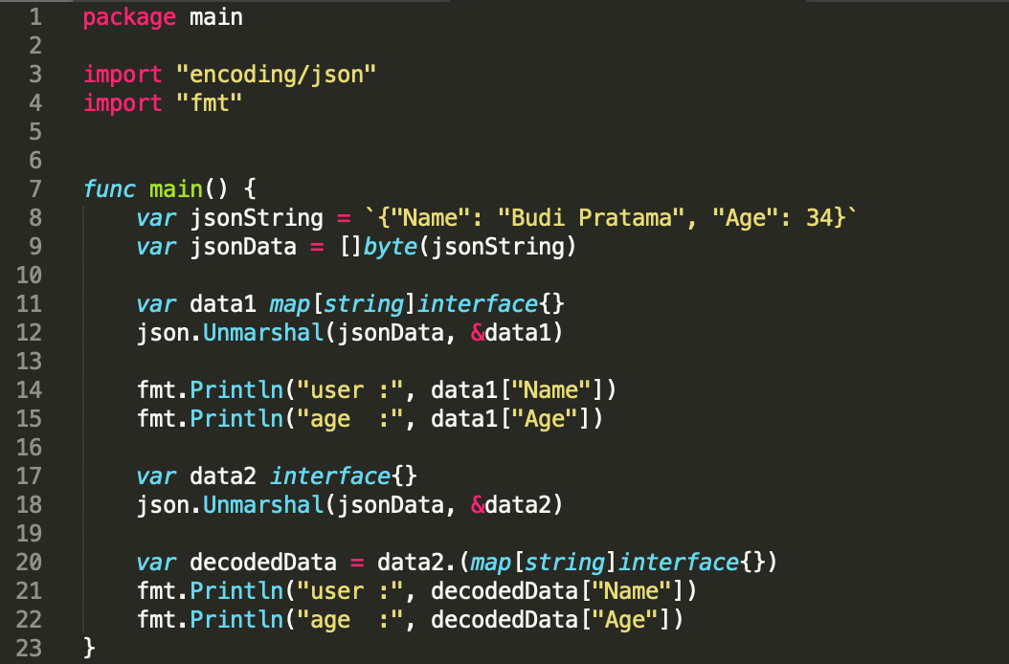
JSON – Decode JSON to map[string]interface{} & interface{}

Slide 16
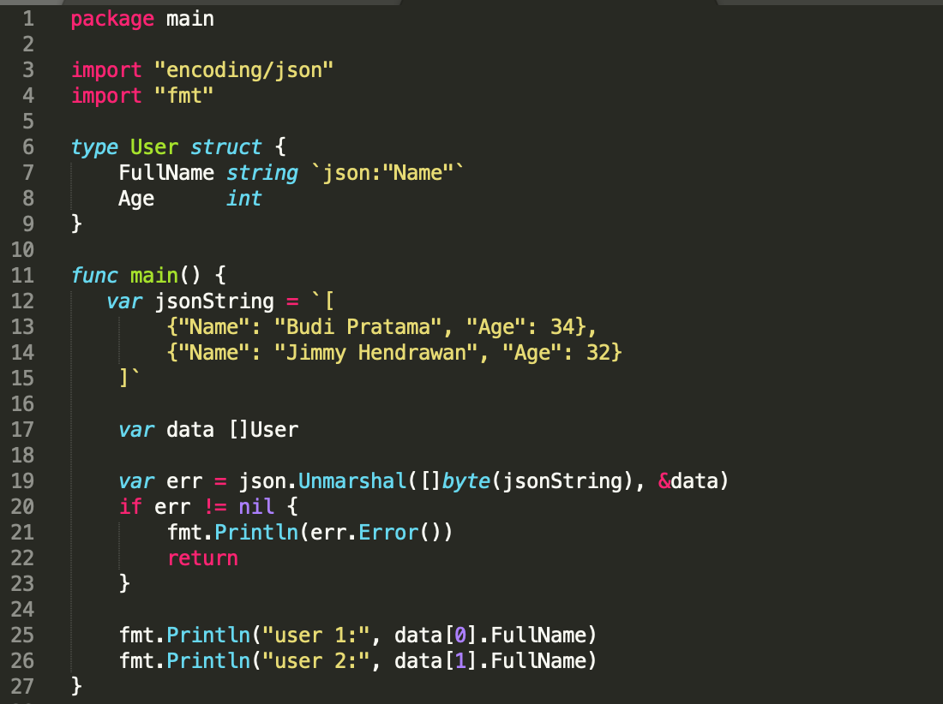
JSON – JSON Array to Object Array

Slide 17
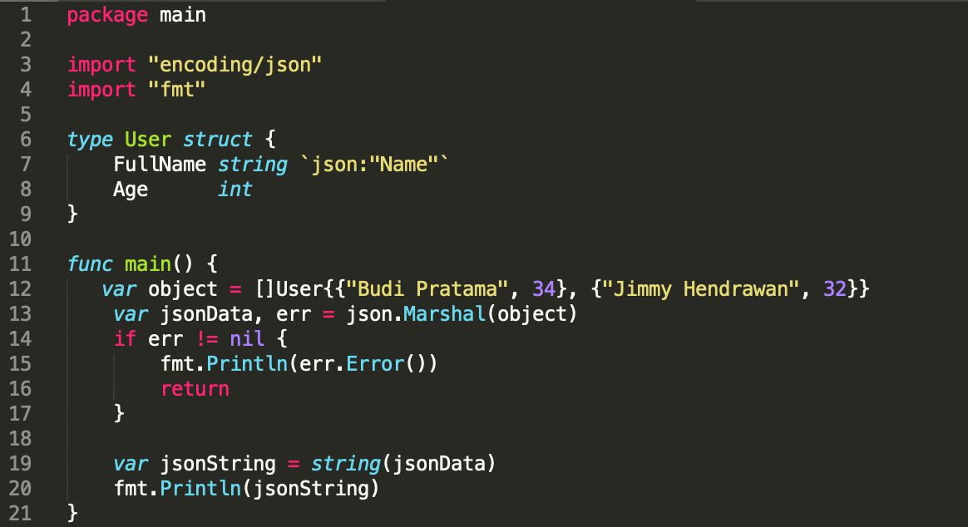
JSON – Encode Object to JSON

Slide 18
Summary
Web
URL Parsing
JSON

Slide 19
